Slide 1
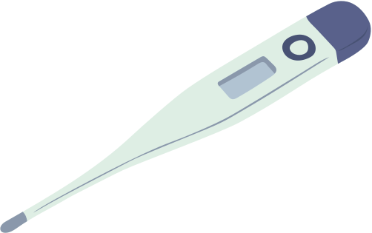
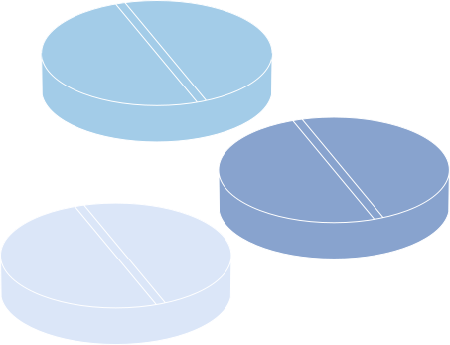

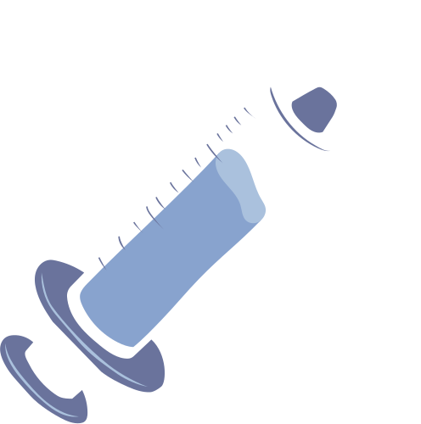
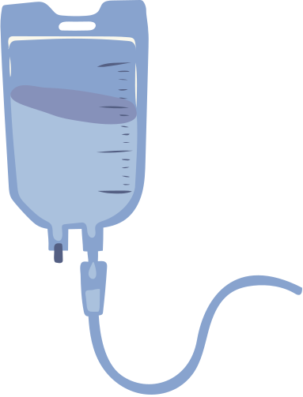




Health Monitoring System with Real Time Alerts

Slide 2



Abstract
A real-time health monitoring system using AI and machine learning for user safety and emergency response.
Tracks health metrics like BP, HRV, SpO2, and blood sugar continuously.
Fall prediction system triggers alerts to caregivers or doctors when risk is high.
AI chatbot gives personalized health recommendations based on user data.
Machine learning models (SVM, LR, KNN, Naïve Bayes, RF) detect anomalies and predict health risks.
Built with Streamlit UI and stores user data in CSV for long-term health analysis.

Slide 3
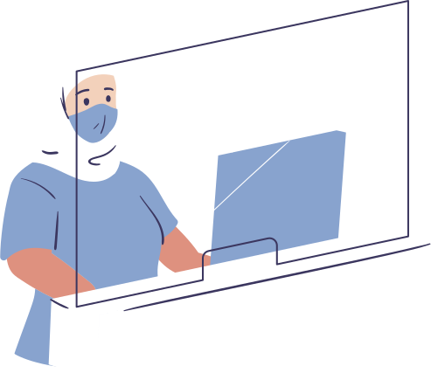

Problem Statement
Current health monitoring systems lack proactive fall detection, especially for the elderly and mobility-impaired.
Rely on manual or infrequent assessments, often missing subtle walking pattern changes.
No real-time analysis or automated fall risk prediction increases risk of injuries.
Individuals in remote or solo living situations lack instant health advice.
Manual walking data entry is error-prone, limiting accurate risk analysis.
Existing tools are not user-friendly or accessible for ongoing monitoring.
The proposed system solves these by:
Analyzing step count and walking data using OCR & manual input.
Using rule-based scoring for real-time fall risk alerts.
Offering AI chatbot support via Gemini API for health advice.
Providing a visual, user-friendly web interface built with Streamlit.
Storing user data in CSV for long-term trend analysis and proactive care.

Slide 4
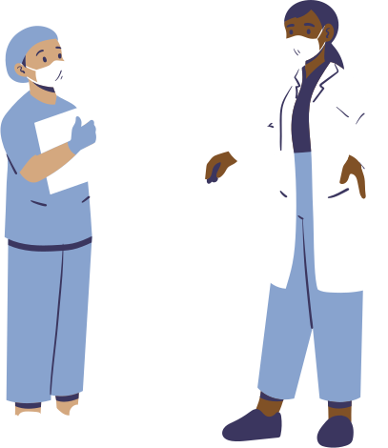
Functional Requirements (SRS)
Functional Requirements
Login/Register: Secure user authentication and access control.
Dashboard: Central platform showing health data and system modules.
Health Data Input: Manual input or image upload for BP, HRV, Sugar, SpO₂.
Alert Care Taker: Auto-SMS/Calls via Twilio API on critical health alerts.
Health Guidelines: Personalized advice on lifestyle, prevention, and next steps.
Chatbot: Gemini AI-based assistant for health advice and navigation.

Slide 5
Non-Functional Requirements (SRS)
Non-Functional Requirements
Performance: Real-time health data processing and alert generation.
Security & Privacy: Data encryption and secure login protocols.
Scalability: Supports multiple users and large data sets.
Reliability: 99.9% uptime and dependable alert system.
Usability & Accessibility: Simple UI, elderly-friendly.
Maintainability: Modular code, easy updates and upgrades.

Slide 6


UML Diagrams
UML diagrams are classified into three main categories:
Structural Diagrams: Depict the static structure of a system. Examples include Class Diagrams, Object Diagrams, Component Diagrams, and Package Diagrams.
Behavioural Diagrams: Describe the dynamic behaviour of a system. Examples include Use Case Diagrams, Sequence Diagrams, Activity Diagrams, and State Machine Diagrams.
Interaction Diagrams: Focus on the interactions between objects or components within the system. Examples include Sequence Diagrams and Communication Diagrams.

Slide 7
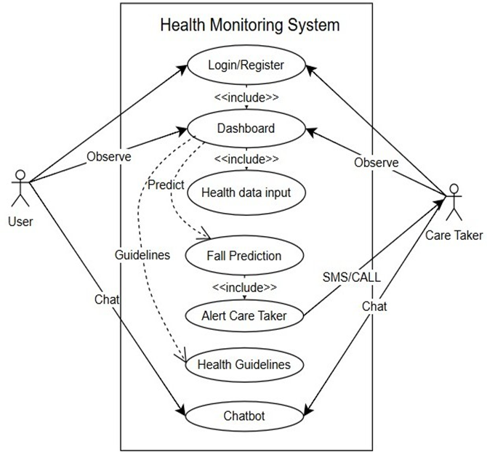
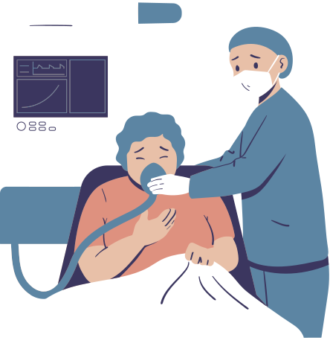

UseCase Diagram

Slide 8
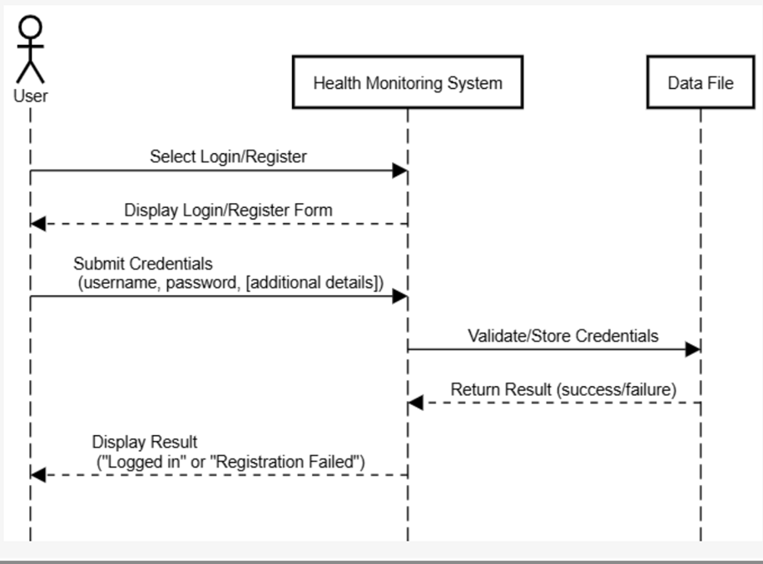
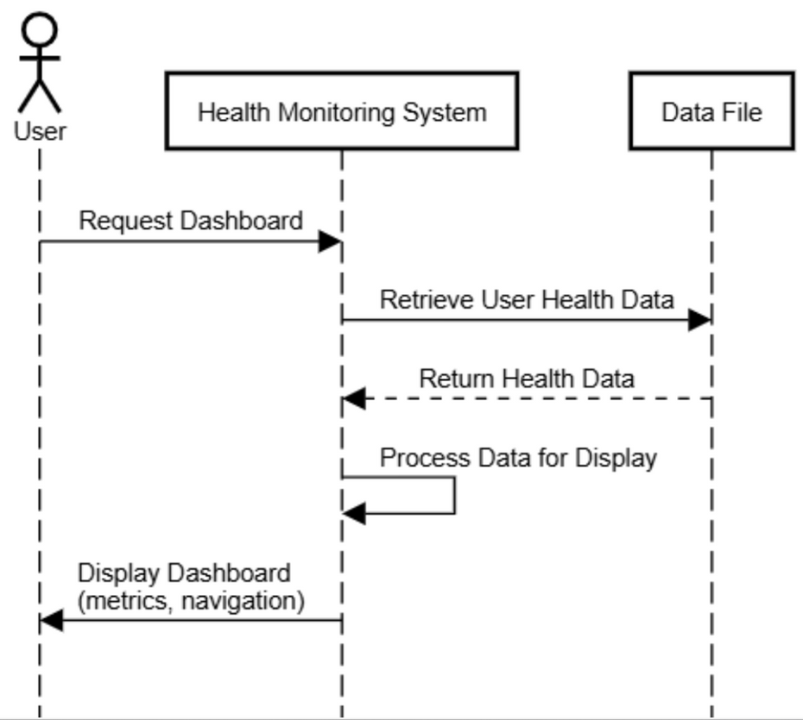
Sequence Diagram

Slide 9
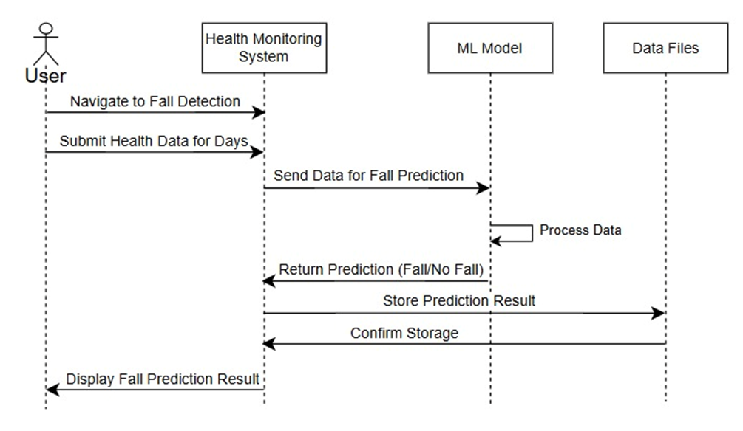
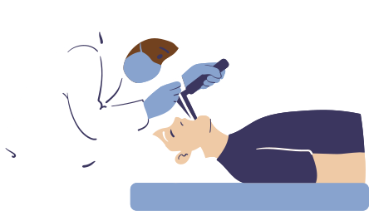

Slide 10
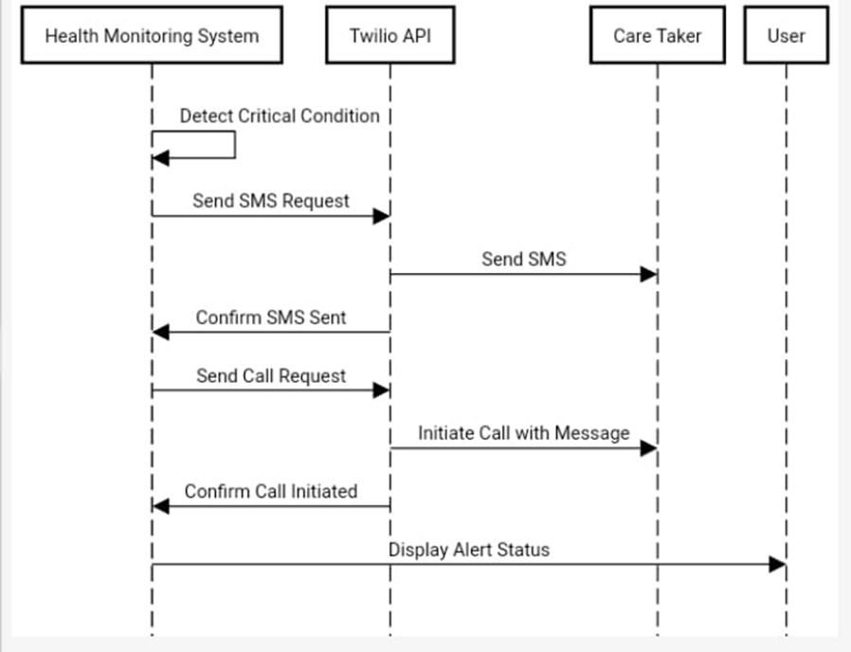

Slide 11

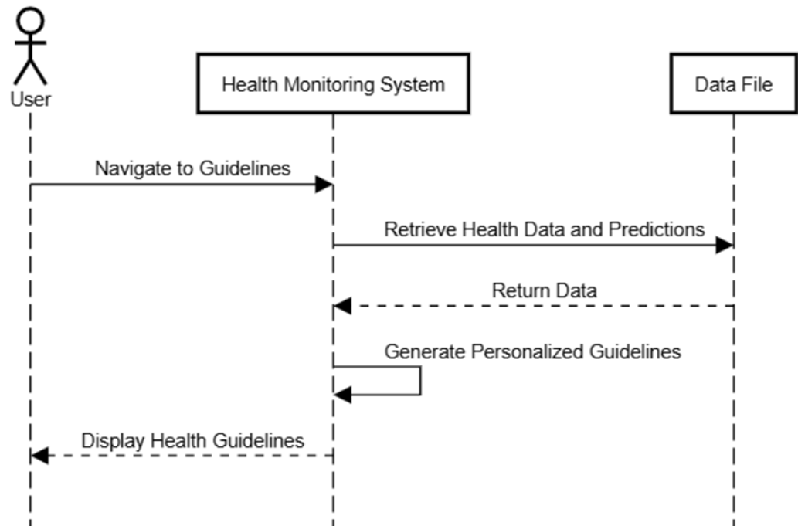
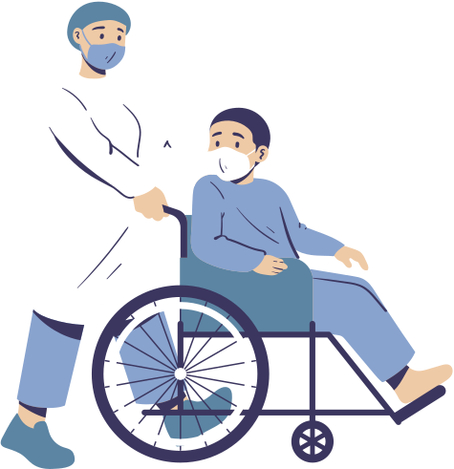

Slide 12
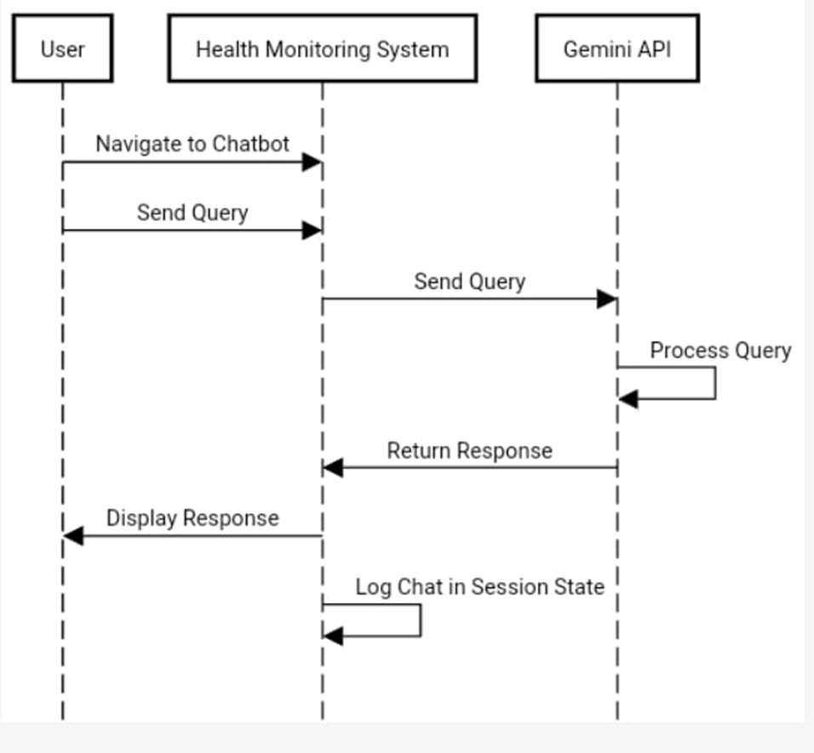

Slide 13
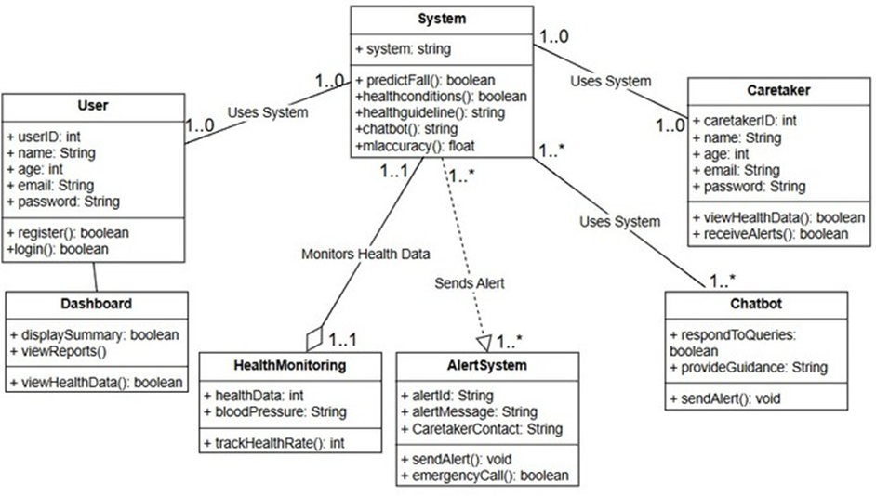


Class Diagram

Slide 14
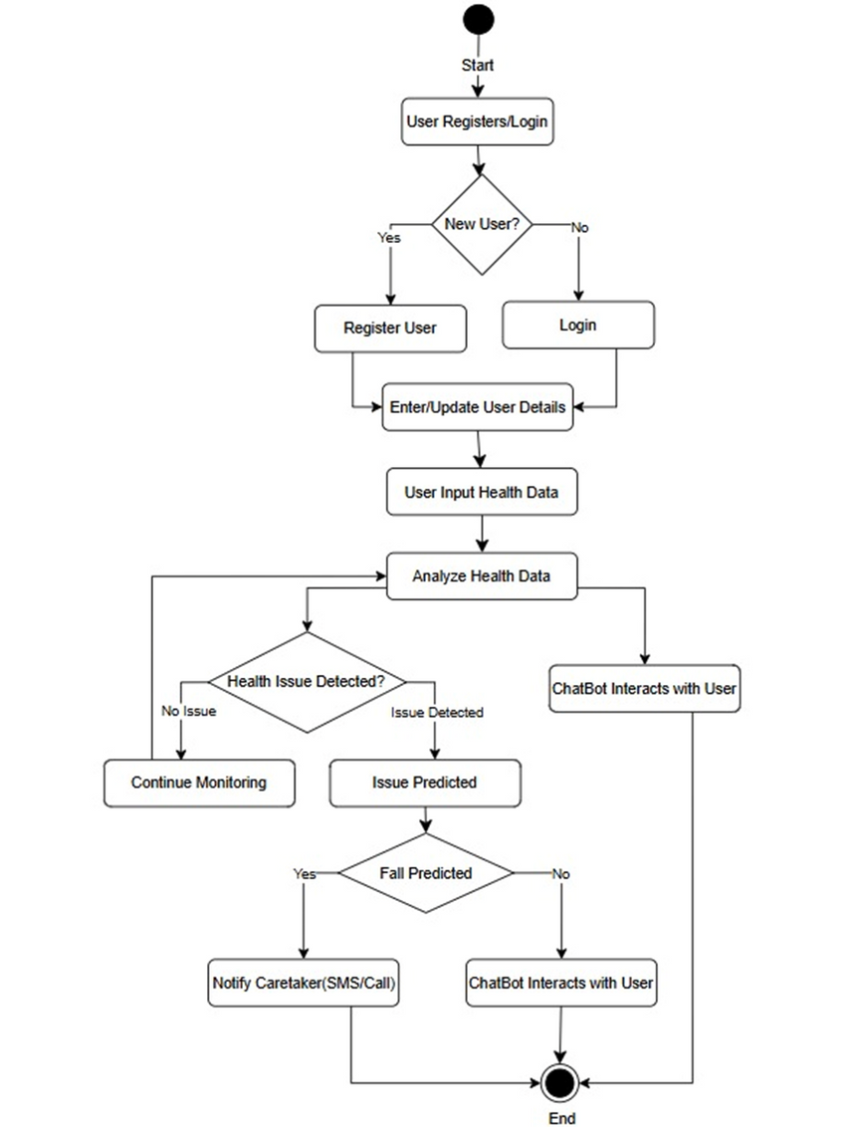
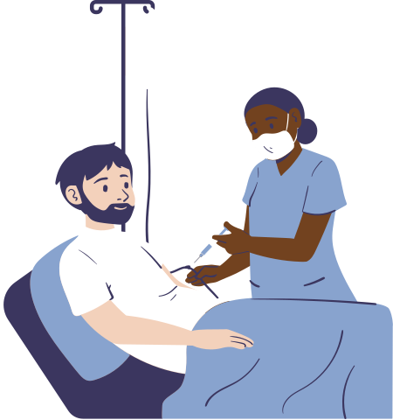
Activity Diagram

Slide 15
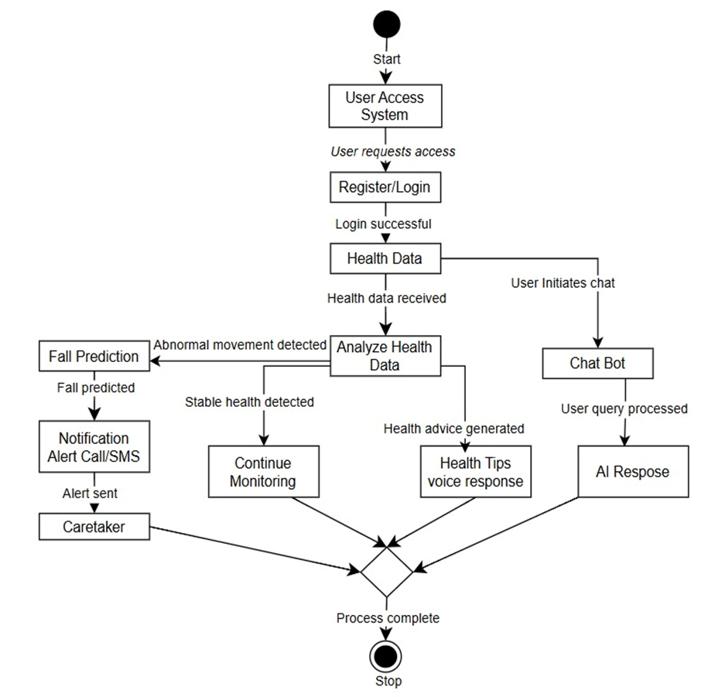
State Chart Diagram

Slide 16
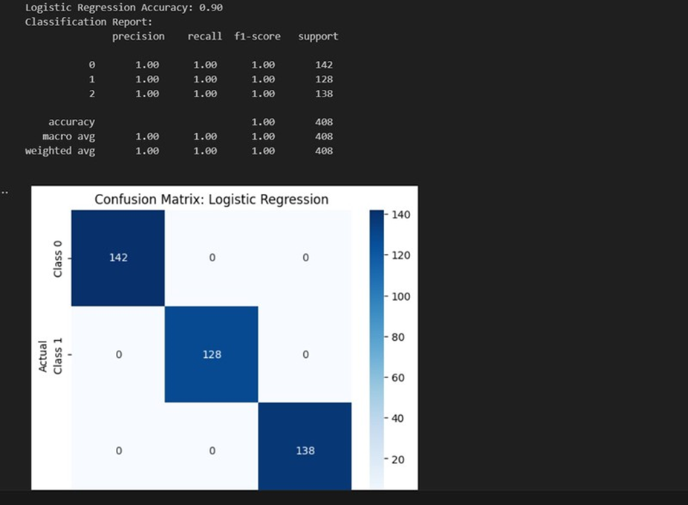
Machine Learning Algorithms
Logistic Regression
LogisticRegression is a statistical method used for binary and multiclass classification problems.It predicts the probability of an instancebelonging to a certainclass using the logistic (sigmoid) function.
Advantages: Simple, efficient, interpretable.
Disadvantages: Assumes a linear decisionboundary, sensitive to outliers.
Observations from Output
Accuracy: 90%
Confusion Matrix: The model correctly classified all instances.
Interpretation: The classifier performs well but is slightlyless accurate than SVM.

Slide 17
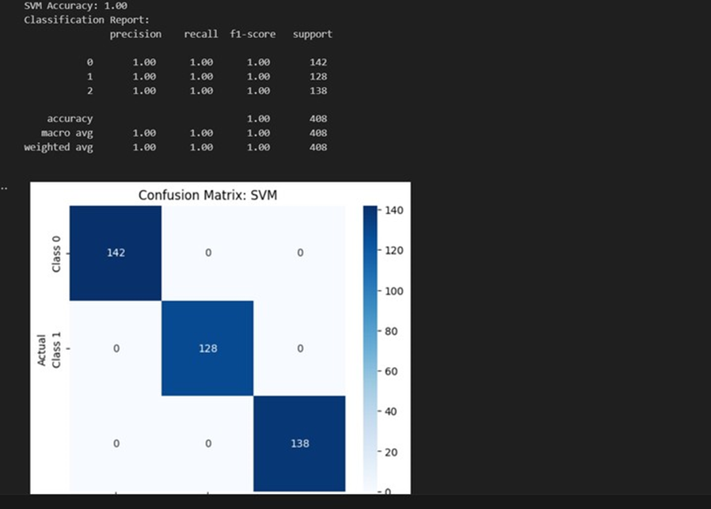
Support Vector Machine (SVM)
SVM is a powerful classification algorithm that finds the optimal hyperplane that best separates different classes. It is particularly effective for high-dimensional data and works well even with non-linearly separable data using kernels.
Advantages: Works well with smalldatasets, robust to overfitting, effective in high-dimensional spaces.
Disadvantages: Computationally expensivefor large datasets,requires parameter tuning.
Observations from Output
Accuracy: 100%
Confusion Matrix: No misclassification; all instancesclassified correctly.
Interpretation: This modelperformed best, achieving perfect classification

Slide 18
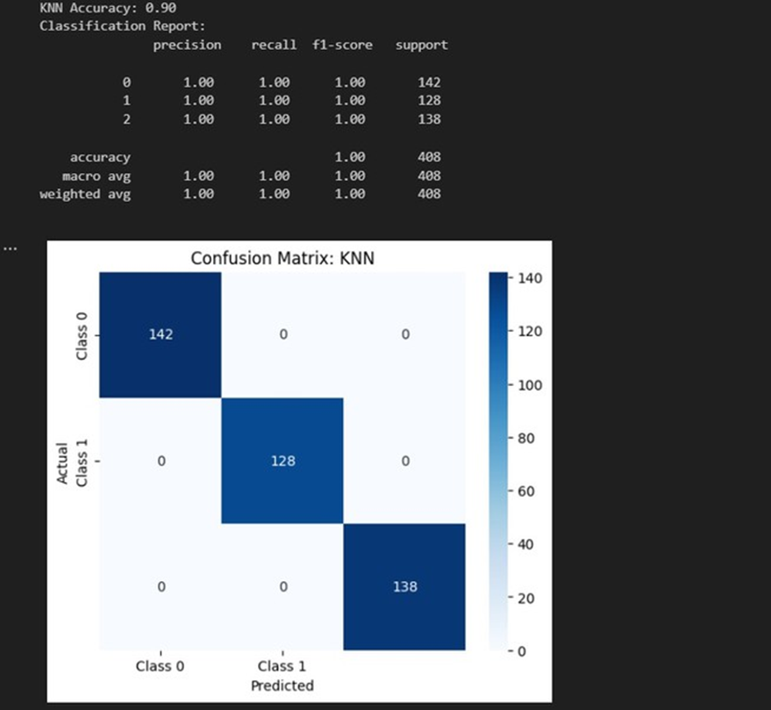
K-Nearest Neighbors (KNN)
KNN is a non-parametric, instance-based learning algorithm that classifies new data points based on the majority class of their k nearest neighbors.
Advantages: Simple, effective for small datasets, no training phase.
Disadvantages: Computationally expensive, sensitive to noise and irrelevant features.
Observations from Output
Accuracy: 90%
Confusion Matrix: The model correctly classified all instances.
Interpretation: The model performs well but requirescareful tuning of K (number of neighbors).

Slide 19
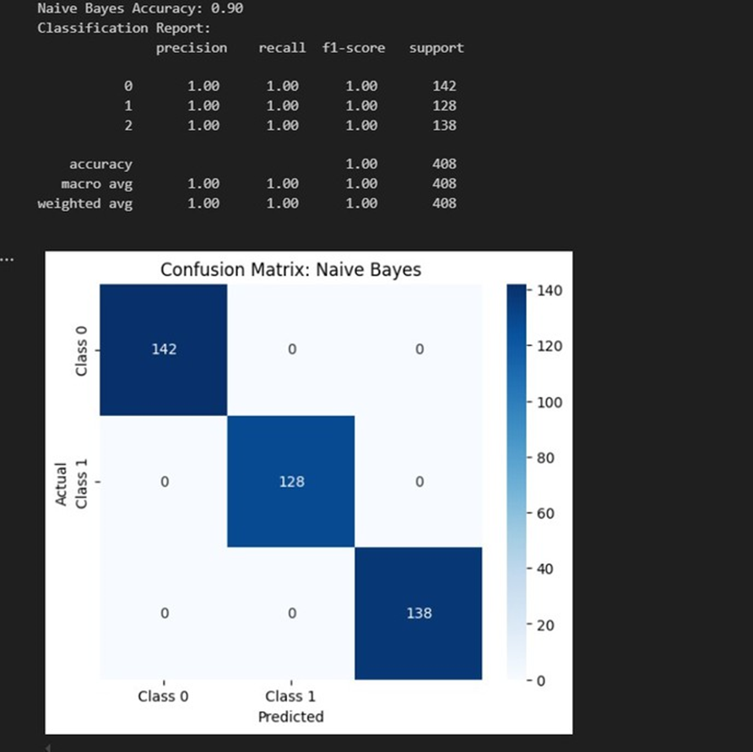
Naive Bayes
Naive Bayes is a probabilistic classifier based on Bayes' theorem, assuming independence between features.It is commonly used for text classification and spam filtering.
Advantages: Fast, efficient, performs well with small datasets.
Disadvantages: Assumes featureindependence, may not work well when features are correlated.
Observations from Output
Accuracy: 90%
Confusion Matrix: The model correctly classified all instances.
Interpretation: Works well for this datasetbut performs slightlyworse than SVM.

Slide 20
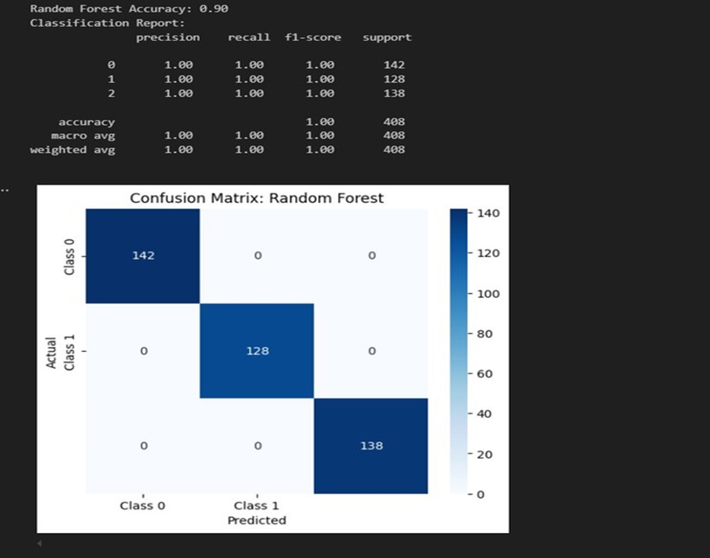
Random Forest
Random Forest is an ensemble learningalgorithm that builds multiple decision trees
and combines their predictions. It reduces overfitting and improves accuracy.
Advantages: Handles missingvalues, reduces overfitting, works well with both numerical and categorical data.
Disadvantages: Can be computationally expensive and difficult to interpret.
Observations from Output
Accuracy: 90%
Confusion Matrix: The model correctly classified all instances.
Interpretation: Good accuracy, but not betterthan SVM.

Slide 21
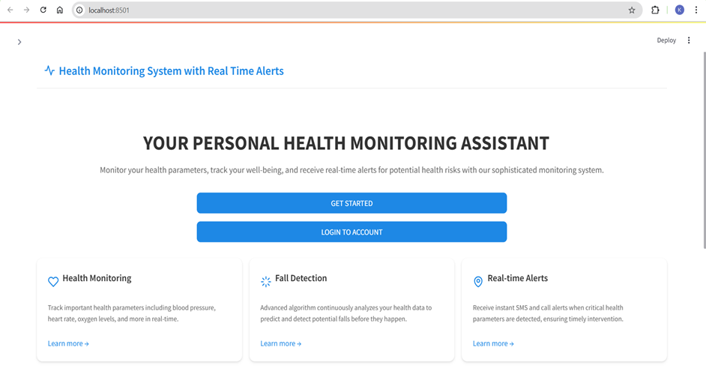
Execution Demo
Home Page
Accuracy: 90%
Confusion Matrix: The model correctly classified all instances.
Interpretation: Good accuracy, but not betterthan SVM.

Slide 22
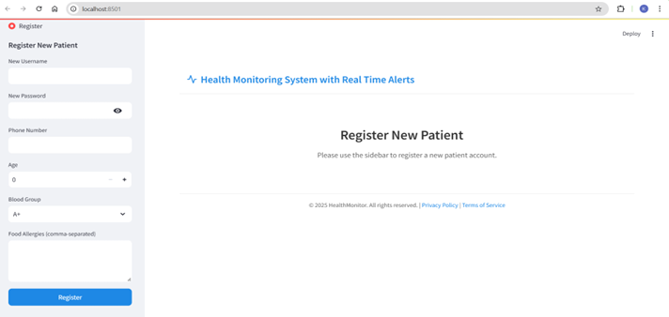
Register Page
The Health Monitoring System with Real-Time Alerts registration page allows new patients to create an account by providing essential details like username, password, phone number, age, blood group, and food allergies.

Slide 23
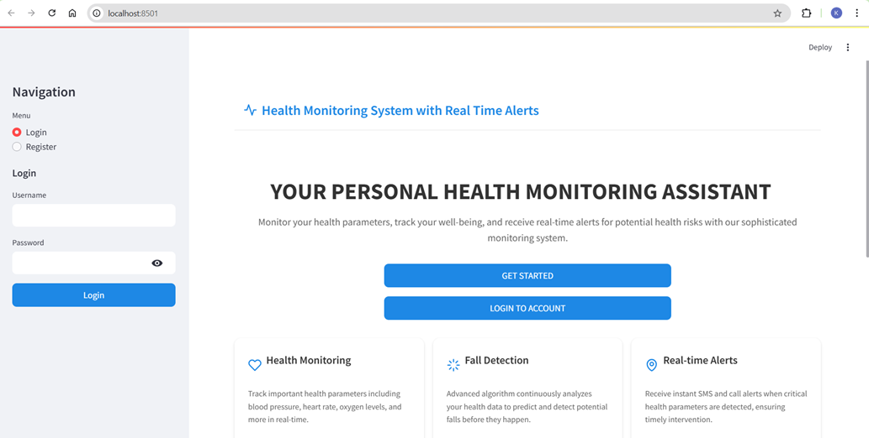
Login Page
The Health Monitoring System with Real-Time Alerts login page provides a secure entry point for users to access their personal health monitoring dashboard with options to log in or register.

Slide 24
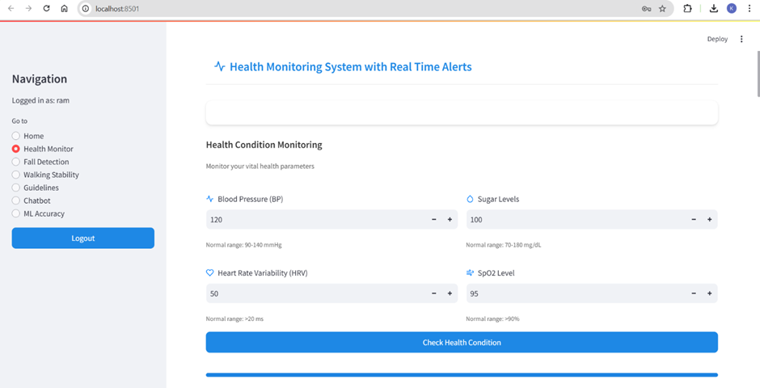
Health Monitor
The Health Monitoring System with Real-Time Alerts health monitor page enables users to input and track vital health parameters like blood pressure, HRV, sugar levels, and SpO2, with immediate condition analysis.

Slide 25
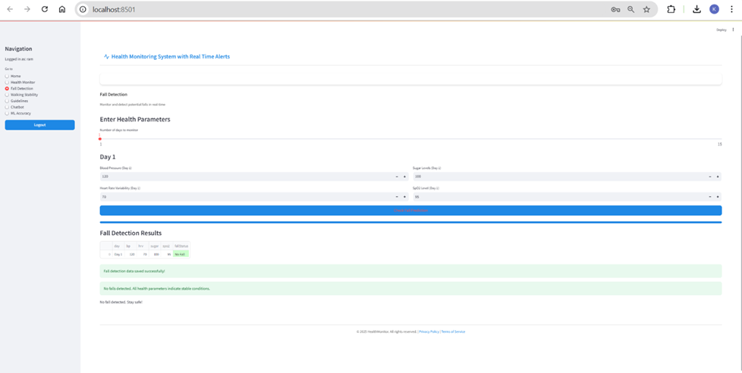
Fall Detection
The Health Monitoring System with Real-Time Alerts fall detection page allows users to monitor fall risks by entering health parameters over a specified period, displaying results with alerts and recommendations for detected falls.

Slide 26
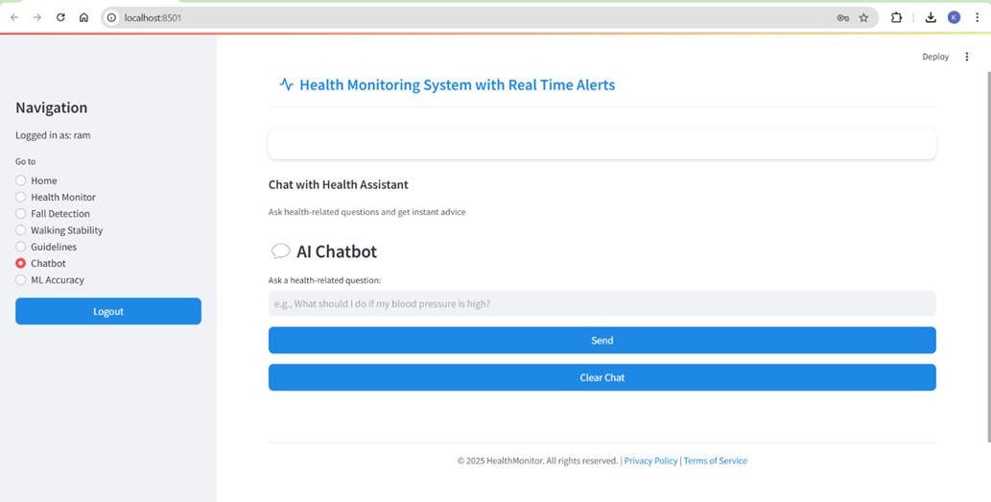
Chatbot
The Health Monitoring System with Real-Time Alerts chatbot page enables users to ask health-related questions and receive instant advice from an AI-powered health assistant, with options to send queries or clear the chat.

Slide 27
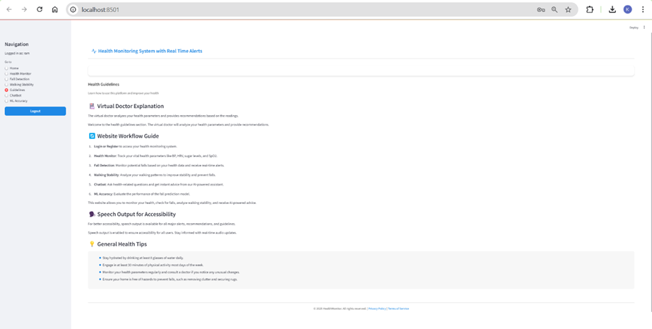
Guidelines
The Health Monitoring System with Real-Time Alerts guidelines page provides a virtual doctor explanation, step-by-step usage instructions, speech output for accessibility, and general health tips to improve user health and prevent falls.

Slide 28
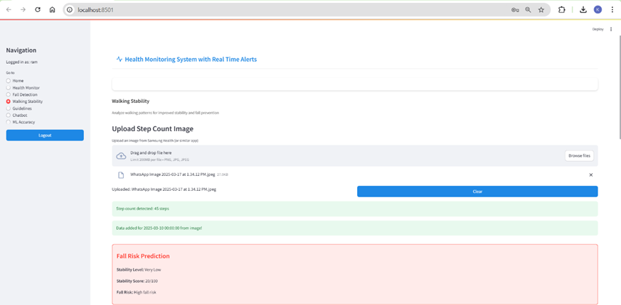
Walking Stability
A health monitoring system interface displays a step count image upload feature with a "Very Low" stability prediction and high fall risk alert.

Slide 29
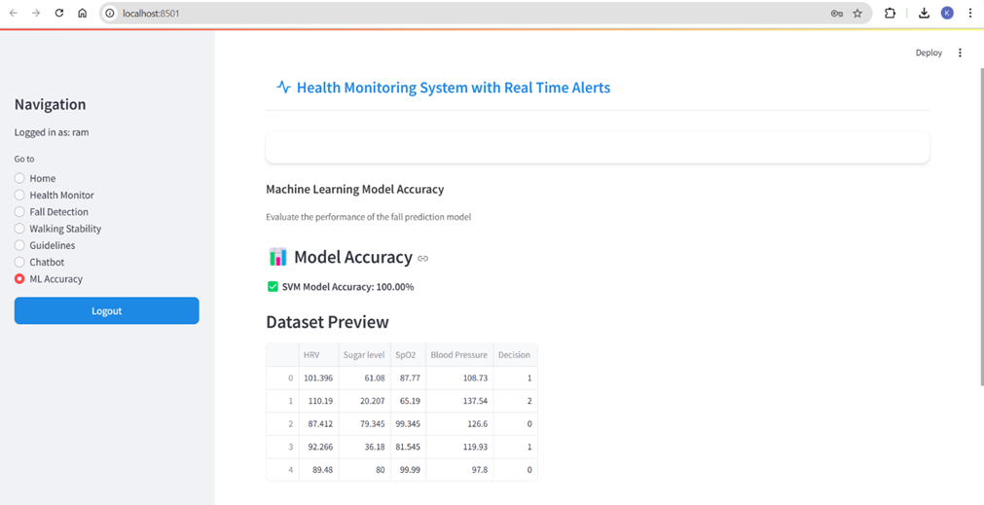
ML Accuracy
The Health Monitoring System with Real-Time Alerts machine learning model accuracy page evaluates the performance of the fall prediction model, displaying a 100% accuracy for the SVM model and a dataset preview of health parameters.

Slide 30
Test Cases
We tested all key functionalities of the Health Monitoring System prototype:
🔐 Login/Register: Successful authentication using test credentials.
📊 Dashboard: Real-time health summaries and visualizations shown after login.
📝 Health Data Input: Manual data entry of BP, HRV, Sugar, and SpO₂ was stored and displayed correctly.
⚠️ Fall Prediction: AI model detected fall risk accurately with abnormal input values.
📱 Alert to Caretaker: Twilio API triggered SMS successfully when fall was detected.
📚 Health Guidelines: Based on health input, the system recommended personalized health tips.
🤖 Chatbot: AI chatbot provided correct and relevant health responses using Gemini API.
✔️ All test cases passed with expected results.

Slide 31

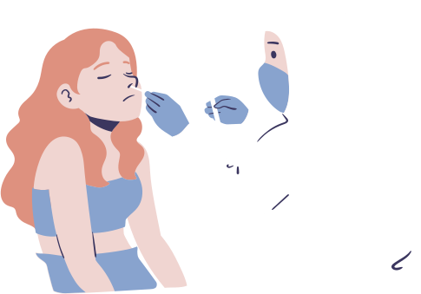
Conclusion
The Health Monitoring and Alert System ensures user safety and health through real-time tracking and AI-based decision making.
🔹 Key Technologies Used:
Python for data processing
Streamlit for UI
Scikit-learn (SVM) for fall prediction
Twilio API for alerts
Google Gemini AI for chatbot
CSV for lightweight data storage
🔹 Major Highlights:
📈 Tracks BP, HRV, Sugar, SpO₂
🚨 Detects fall risk and alerts caretakers
🤖 AI chatbot for instant guidance
📊 Intuitive UI for all age groups

Slide 32
Future Scope
To improve system scalability and user experience, future enhancements include:
🗃️ Database Integration: Use MySQL or MongoDB for better data handling
📡 IoT Integration: Add wearable health devices for live data
📱 Mobile App: Build Android/iOS apps for easier access
🧠 Smarter AI Chatbot: Use advanced NLP for more natural conversations

Slide 33
Thank you for your attention

